Slide 1
Singly Linked List (SLL)

Slide 2
Instructor
Dr. Ab Rouf Khan
Assistant Professor
VIT Bhopal University

Slide 3
Entry level Questions
Why Linked Lists, when we already have arrays?
How to carry out the operations similar to arrays in the Linked Lists?
How can the Linked Lists possibly be implemented?

Slide 4
Outline [Module 3 (Part 1)]
Linked List
Arrays vs Linked Lists
Singly Linked List
Doubly Linked List
Circular Linked List
Implementation
Applications

Slide 5
Two Standard Data Structures
1
2
3
4
5
6
7
8
9
10
1
0
1
1
0
1
0
1
0
0
Array: a vector: stored consecutively in memory, and typically allocated in advance
first
This is a singly linked list
1
6
3
8
4
cells: hold fields of numbers and pointers to implement lists.

Slide 6
Representations of subsets of a set
subset S = {1, 3, 4, 6, 8}
1
2
3
4
5
6
7
8
9
10
Array A
1
0
1
1
0
1
0
1
0
0
first
List L
1
6
3
8
4
The choice of data structure depends on what operations need to be carried out.

Slide 7
Example 1: Creating an empty set
Initialize: subset S = ∅
1
2
3
4
n
0
0
0
0
…
0
O(n) steps
first
O(1) steps
0

Slide 8
Example 2: Does x ∈ S?
Does 9 ∈ S?
1
2
3
4
5
6
7
8
9
10
1
0
1
1
0
1
0
1
0
0
O(1) steps
first
To determine if 9 ∈ S?, one needs to scan the entire list.
1
6
3
8
4
O(n) steps

Slide 9
Representing a linked list as an array
first
1
6
3
8
4
1
2
3
4
5
6
7
8
9
10
Array: Next
6
8
∅
3
4
If Next(j) is empty, then j is not on the list
If Next(j) = ∅, then j is the last element on the list

Slide 10
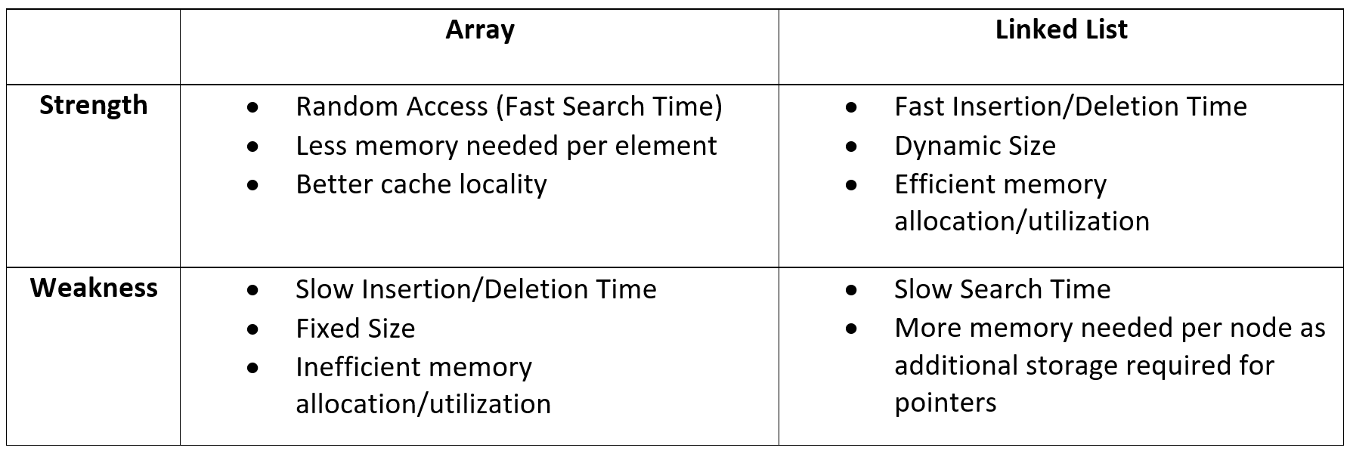
Arrays vs Linked List (Summary)

Slide 11
Abstract Data Type (ADT)
Data type
a set of objects + a set of operations
Example: integer
set of whole numbers
operations: +, -, x, /
Can this be generalized?
(e.g. procedures generalize the notion of an operator)
Yes!
Abstract data type
high-level abstractions (managing complexity through abstraction)
Encapsulation

Slide 12
Encapsulation
Operation on the ADT can only be done by calling the appropriate function
no mention of how the set of operations is implemented
The definition of the type and all operations on that type can be localized to one section of the program
If we wish to change the implementation of an ADT
we know where to look
by revising one small section we can be sure that there is no subtlety elsewhere that will cause errors
We can treat the ADT as a primitive type: we have no concern with the underlying implementation
ADT → C++: class
method → C++: member function

Slide 13
ADT (Continued …)
Examples
the set ADT
A set of elements
Operations: union, intersection, size and complement
the queue ADT
A set of sequences of elements
Operations: create empty queue, insert, examine, delete, and destroy queue
Two ADT’s are different if they have the same underlying model but different operations
E.g., a different set ADT with only the union and find operations
The appropriateness of an implementation depends very much on the operations to be performed

Slide 14
Pros and Cons of ADT
Implementation of the ADT is separate from its use
Modular: one module for one ADT
Easier to debug
Easier for several people to work simultaneously
Code for the ADT can be reused in different applications
Information hiding
A logical unit to do a specific job
implementation details can be changed without affecting user programs
Allow rapid prototyping
Prototype with simple ADT implementations, then tune them later when necessary
Loss of efficiency

Slide 15
The List ADT
A sequence of zero or more elements
A₁, A₂, A₃, … A_{N}
N: length of the list
A₁: first element
A_{N}: last element
A_{i}: position i
If N=0, then empty list
Linearly ordered
A_{i} precedes A_{i+1}
A_{i} follows A_{i-1}

Slide 16
Operations on the List ADT
printList: print the list
makeEmpty: create an empty list
find: locate the position of an object in a list
list: 34,12, 52, 16, 12
find(52) → 3
insert: insert an object to a list
insert(x,3) → 34, 12, 52, x, 16, 12
remove: delete an element from the list
remove(52) → 34, 12, x, 16, 12
findKth: retrieve the element at a certain position

Slide 17
Implementation of an ADT
Choose a data structure to represent the ADT
E.g. arrays, records, etc.
Each operation associated with the ADT is implemented by one or more subroutines
Two standard implementations for the list ADT
Array-based
Linked list

Slide 18
Linked List
A
B
C
∅
Head
A linked list is a series of connected nodes
Each node contains at least
A piece of data (any type)
Pointer to the next node in the list
Head: pointer to the first node
The last node points to NULL
node
A
data
pointer

Slide 19
Linked List – More Terminology
A node’s successor is the next node in the sequence
The last node has no successor
A node’s predecessor is the previous node in the sequence
The first node has no predecessor
A list’s length is the number of elements in it
A list may be empty (contain no elements)

Slide 20
A simple Linked List Class
We use two classes: Node and List
Declare Node class for the nodes
data: double-type data in this example
next: a pointer to the next node in the list
class Node {
public:
double data; // data
Node* next; // pointer to next
};

Slide 21
A simple Linked List Class
Declare List, which contains
head: a pointer to the first node in the list.
Since the list is empty initially, head is set to NULL
Operations on List
class List {
public:
List(void) { head = NULL; } // constructor
~List(void); // destructor
bool IsEmpty() { return head == NULL; }
Node* InsertNode(int index, double x);
int FindNode(double x);
int DeleteNode(double x);
void DisplayList(void);
private:
Node* head;
};

Slide 22
A simple Linked List Class
Operations of List
IsEmpty: determine whether or not the list is empty
InsertNode: insert a new node at a particular position
FindNode: find a node with a given value
DeleteNode: delete a node with a given value
DisplayList: print all the nodes in the list

Slide 23
Traversing a SLL
The following method traverses a list (and prints its elements):
public void printFirstToLast() {
for (SLLNode curr = first;
curr != null;
curr = curr.succ) {
System.out.print(curr.element + " ") }
You would write this as an instance method of the SLL class

Slide 24
Traversing a SLL
curr
head
one
two
three

Slide 25
Inserting a new Node
Node* InsertNode(int index, double x)
Insert a node with data equal to x after the index’th elements.
(i.e., when index = 0, insert the node as the first element;
when index = 1, insert the node after the first element, and so on)
If the insertion is successful, return the inserted node.
Otherwise, return NULL.
(If index is < 0 or > length of the list, the insertion will fail.)
Steps
Locate index’th element
Allocate memory for the new node
Point the new node to its successor
Point the new node’s predecessor to the new node
index’th element
newNode

Slide 26
Inserting a new Node
Possible cases of InsertNode
Insert into an empty list
Insert in front
Insert at back
Insert in middle
But, in fact, only need to handle two cases
Insert as the first node (Case 1 and Case 2)
Insert in the middle or at the end of the list (Case 3 and Case 4)

Slide 27
Inserting a new Node (After)
node
2.5
head
one
two
three
Find the node you want to insert after
First, copy the link from the node that's already in the list
Then, change the link in the node that's already in the list

Slide 28
Inserting a new Node
Node* List::InsertNode(int index, double x) {
if (index < 0) return NULL;
int currIndex = 1;
Node* currNode = head;
while (currNode && index > currIndex) {
currNode = currNode->next;
currIndex++;
}
if (index > 0 && currNode == NULL) return NULL;
Node* newNode = new Node;
newNode->data = x;
if (index == 0) {
newNode->next = head;
head = newNode;
}
else {
newNode->next = currNode->next;
currNode->next = newNode;
}
return newNode;
}
Try to locate index’th node. If it doesn’t exist, return NULL.

Slide 29
Inserting a new Node
Node* List::InsertNode(int index, double x) {
if (index < 0) return NULL;
int currIndex = 1;
Node* currNode = head;
while (currNode && index > currIndex) {
currNode = currNode->next;
currIndex++;
}
if (index > 0 && currNode == NULL) return NULL;
Node* newNode = new Node;
newNode->data = x;
if (index == 0) {
newNode->next = head;
head = newNode;
}
else {
newNode->next = currNode->next;
currNode->next = newNode;
}
return newNode;}
Create a new node

Slide 30
Inserting a new Node
Node* List::InsertNode(int index, double x) {
if (index < 0) return NULL;
int currIndex = 1;
Node* currNode = head;
while (currNode && index > currIndex) {
currNode = currNode->next;
currIndex++;
}
if (index > 0 && currNode == NULL) return NULL;
Node* newNode = new Node;
newNode->data = x;
if (index == 0) {
newNode->next = head;
head = newNode;
}
else {
newNode->next = currNode->next;
currNode->next = newNode;
}
return newNode;
}
Insert as first element
head
newNode

Slide 31
Inserting a new Node
Node* List::InsertNode(int index, double x) {
if (index < 0) return NULL;
int currIndex = 1;
Node* currNode = head;
while (currNode && index > currIndex) {
currNode = currNode->next;
currIndex++;
}
if (index > 0 && currNode == NULL) return NULL;
Node* newNode = new Node;
newNode->data = x;
if (index == 0) {
newNode->next = head;
head = newNode;
}
else {
newNode->next = currNode->next;
currNode->next = newNode;
}
return newNode;
}
Insert after currNode
currNode
newNode

Slide 32

Recap

Slide 33
Thank You

